Slide 1
EVENT MANAGEMENT SYSTEM
Team members
1.Hayvita R K – 20ITA07
2.Samyuktha R – 20ITA15
3.Shobika R – 20ITA18

Slide 2
SCOPE AND OBJECTIVE:
To connect people and event handlers to organize events and make their memories remarkable.
To help people organize events by choosing their organizers under their roof without searching them in person .
It also helps people choose the best rated organizers and the theme they wish to have for their events.

Slide 3
REQUIREMENTS:
Development Environment : Visual studio code.
Browser : chrome
Server side programming Language: Javascript,java
Front-end: HTML,CSS,Bootsrap.
Back-end: Javascript ,java
Database : MongoDB

Slide 4
List of Modules:
Home page
Login
About
Agents
Events
Pricing
Contacts

Slide 5
OUTPUTS

Slide 6
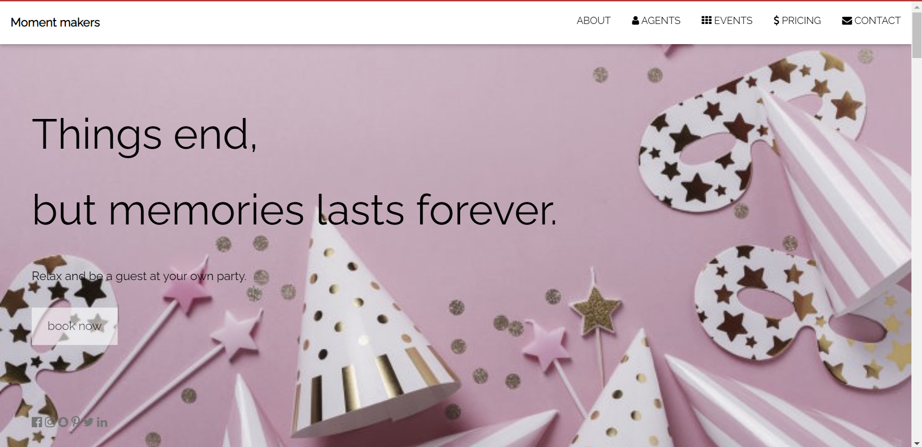
Home page

Slide 7
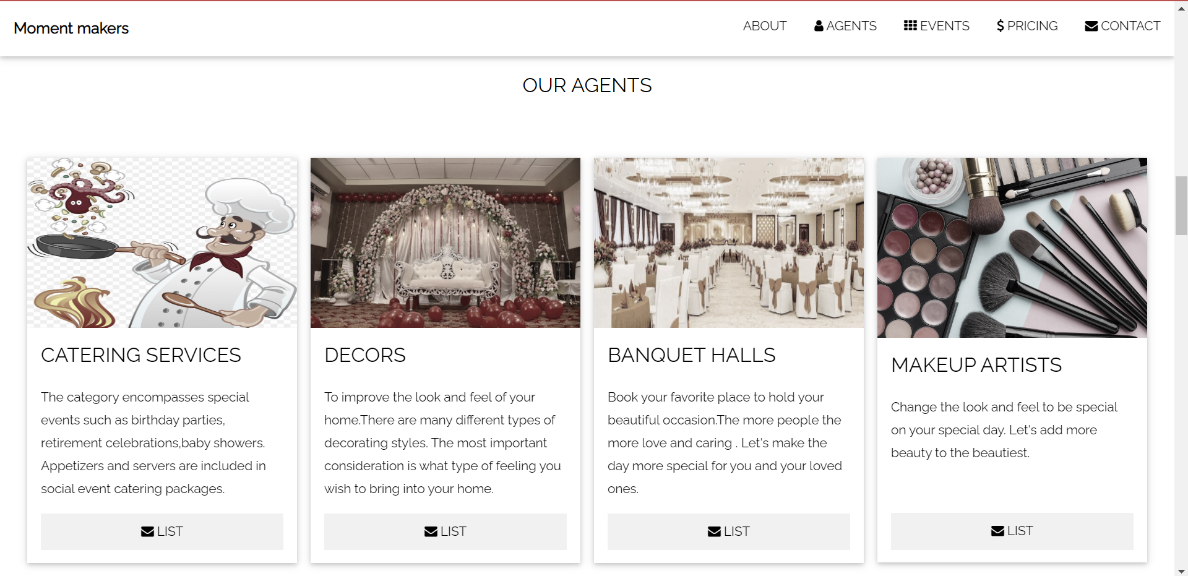
AGENTS

Slide 8
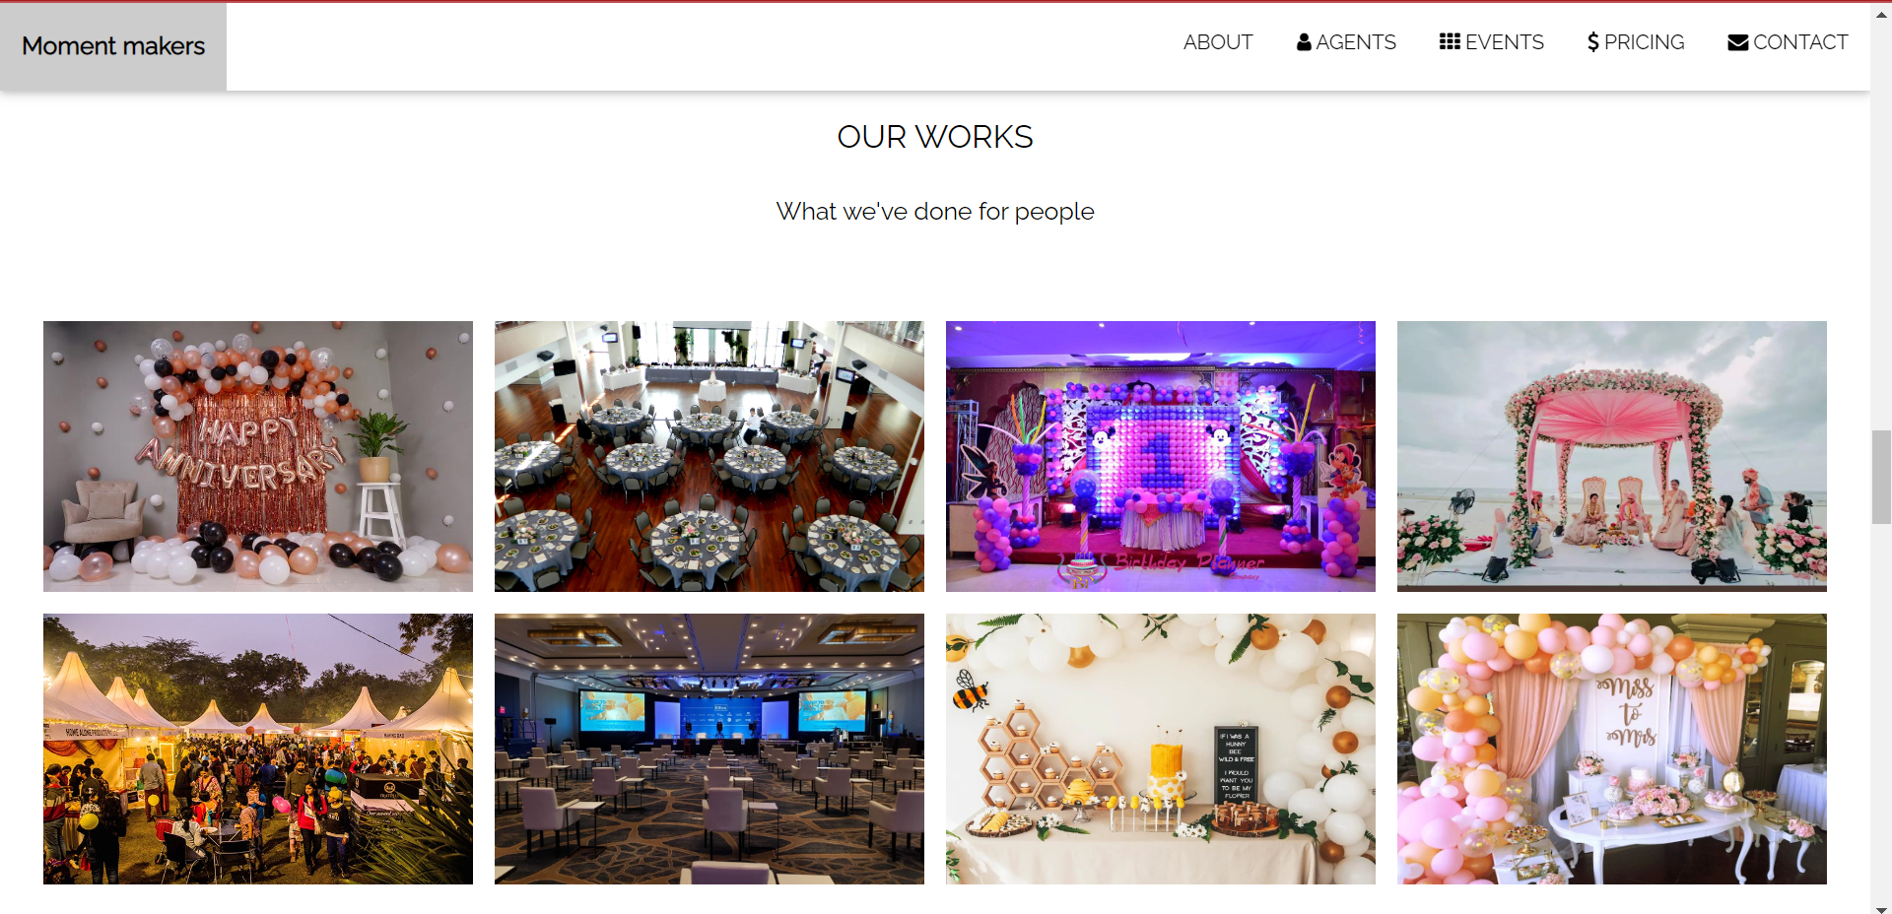
EVENTS

Slide 9
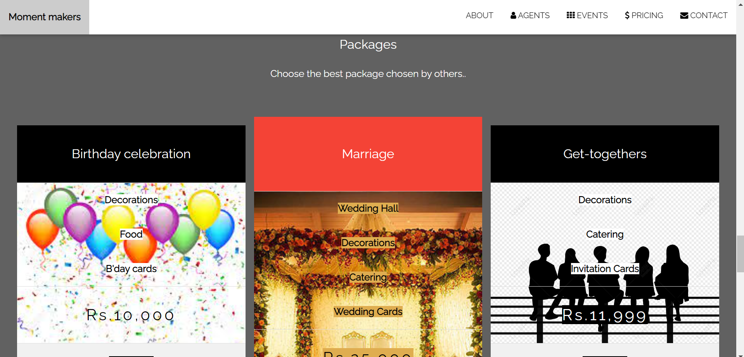
PRICINGS

Slide 10
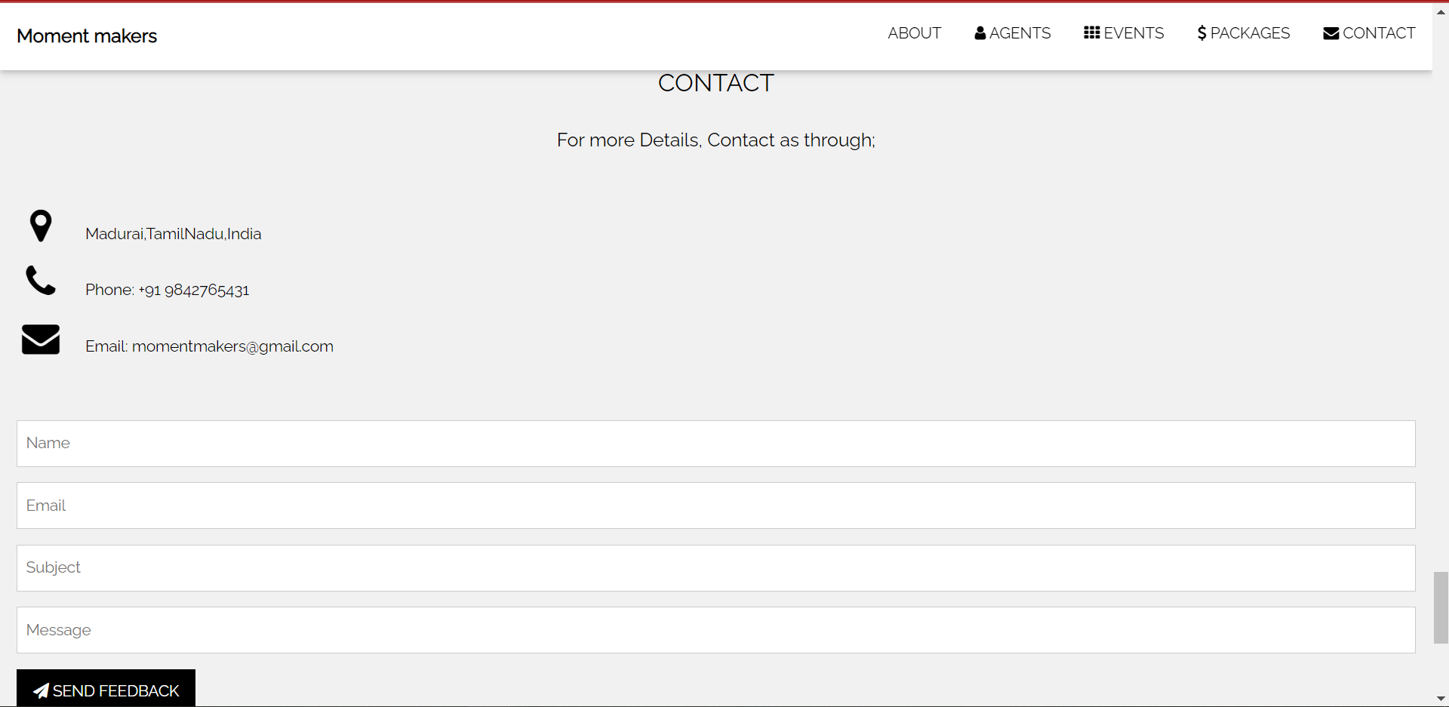
CONTACT

Slide 11
Thank you

